Slide 1
Evaluate web sources
Liberal Studies
7th grade

Slide 2
Open the following website
http://zapatopi.net/treeoctopus/

Slide 3
Answer the following questions on a whiteboard
Where can this animal be found?
Why does the animal change color from red to brown or white?
Why is the animal endangered?
If you were to do research on endangered species, what are the main pieces of information from this website you would use?

Slide 4
The tree octopus doesn’t exist!!!
This website is based on an imaginary animal
DO NOT trust all web sources.
You need to EVALUATE carefully the websites you use

Slide 5
What does the URL tell us?
.com
.edu
.net
.org
.mil
.net

Slide 6
Looking at the URL
.com
Commercial site. The information provided by commercial interests is generally going to shed a positive light on the product it promotes. While this information might not necessarily be false, you might be getting only part of the picture. Remember, there's a monetary incentive behind every commercial site in providing you with information, whether it is for good public relations or to sell you a product outright.

Slide 7
URL
.edu
Educational institution. Sites using this domain name are schools ranging from kindergarten to higher education. Information from sites within this domain must be examined very carefully. If it is from a department or research center at a educational institution, it can generally be taken as credible. However, students' personal Web sites are not usually monitored by the school even though they are on the school's server and use the .edu domain.

Slide 8
URL
.gov
Government. If you come across a site with this domain, then you're viewing a federal government site. All branches of the United States federal government use this domain. Information such as Census statistics, Congressional hearings, and Supreme Court rulings would be included in sites with this domain. The information is considered to be from a credible source.

Slide 9
URL
.org
Traditionally a non-profit organization. Organizations such as the American Red Cross or PBS (Public Broadcasting System) use this domain suffix. Generally, the information in these types of sites is credible and unbiased, but there are examples of organizations that strongly advocate specific points of view over others, such as the National Right to Life Committee and Planned Parenthood. You probably want to give this domain a closer scrutiny these days. Some commercial interests might be the ultimate sponsors of a site with this suffix.

Slide 10
URL
.mil
Military. This domain suffix is used by the various branches of the Armed Forces of the United States.

Slide 11
URL
.net
Network. You might find any kind of site under this domain suffix. It acts as a catch-all for sites that don't fit into any of the preceding domain suffixes. Information from these sites should be given careful scrutiny.

Slide 12
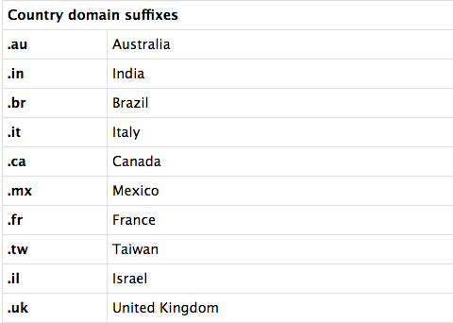
URL

Slide 13
On a scale of 1 to 4, how much is this source reliable? Why?
https://answers.yahoo.com/question/index?qid=20110217125812AApEIM7
http://www.pbs.org/wnet/nature/animal-guide-blue-ringed-octopus/2177/
https://en.wikipedia.org/wiki/Blue-ringed_octopus
http://www.mnn.com/earth-matters/animals/photos/15-cute-animals-that-could-kill-you/blue-ringed-octopus
http://www.nytimes.com/2016/04/14/world/asia/inky-octopus-new-zealand-aquarium.html?_r=0

Slide 14
Evaluate a website using the checklist

