Slide 1
Qu’est-ce que tu aimes faire?
Leçon B

Slide 2
TU VOUS
TU 1. Is singular AND informal
2. Use when speaking to :
a. a child
b. a pet
c. a relative ( even a
grandfather )
d. a friend

Slide 3
TU VOUS
VOUS 1. Is plural OR formal
2. Use when speaking to
a. an adult or older
person, not a relative
b. someone you do
not call by 1st name
c. more than 1 person
of any age

Slide 4
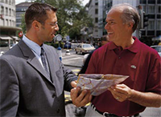
TU or VOUS?
a stranger you ask for directions

Slide 5
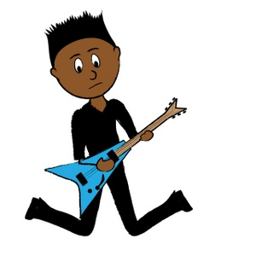
TU or VOUS?
your classmate

Slide 6
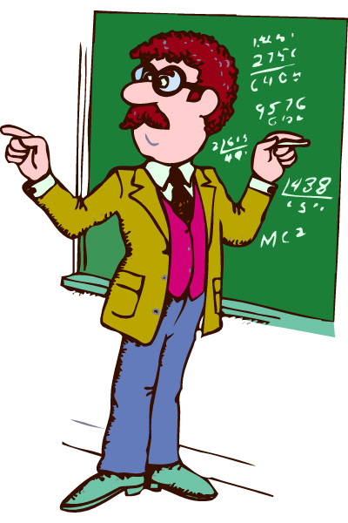
TU or VOUS?
your daughter’s teacher

Slide 7
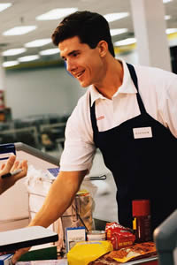
TU or VOUS?
the clerk at the grocery store

Slide 8
TU or VOUS?
your older sister

Slide 9
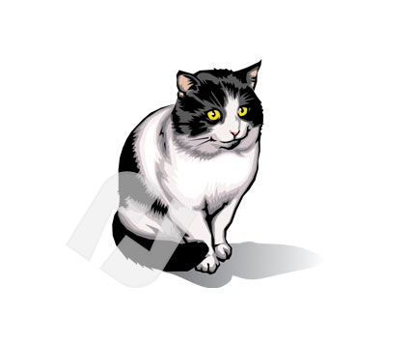
TU or VOUS?
your cat Minet

Slide 10
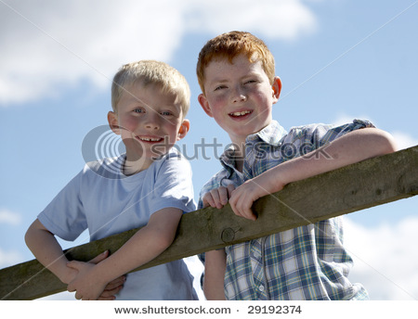
TU or VOUS?
your cousins Yves and Guy

Slide 11
TU or VOUS?
the school librarian

Slide 12
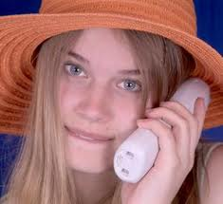
TU or VOUS?
your girlfriend

Slide 13
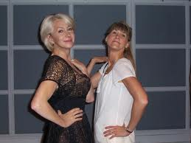
TU or VOUS?
your mom’s friend

Slide 14
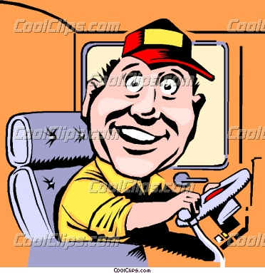
TU or VOUS?
your bus driver

Slide 15
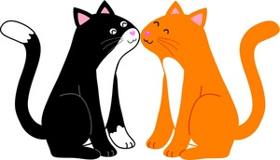
TU or VOUS?
your cats Bernie and CC

Slide 16
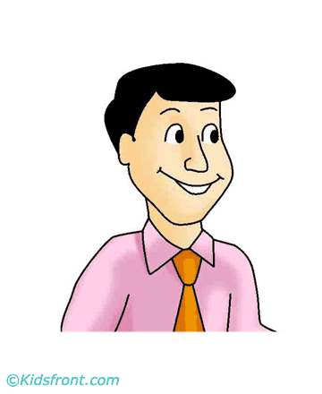
TU or VOUS?
your Oncle Thierry

Slide 17
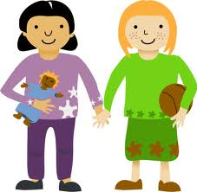
TU or VOUS?
Your 2 best friends

Slide 18
Vocabulary
le footing running
le camping camping
le roller roller-blading
faire du sport to do sports
faire du roller to go roller-blading
faire du vélo to go bike riding

Slide 19
un peu a little
bien really
beaucoup a lot
les films movies

Slide 20
Il aime faire du roller. He likes to go rollerblading.
Elle aime faire du vélo. She likes to go bike riding.
Nous aimons beaucoup faire du footing. We like to go running a lot.
Guillaume aime un peu faire du camping. Guillaume likes to go camping a little.
J'aime le camping. I like camping.

Slide 21
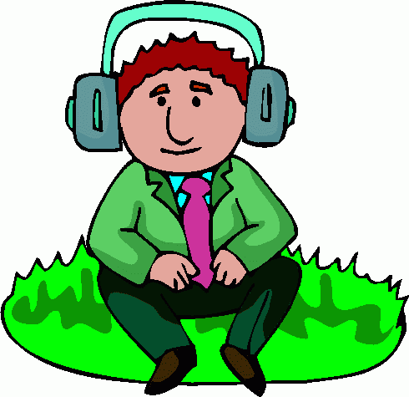
Use the suggested degrees of liking things below. Whether true or not say that’s how much you like doing that activity.
A LOT

Slide 22
J’aime beaucoup écouter de la musique.

Slide 23
I like it a little

Slide 24
J’aime un peu regarder la télé.

Slide 25
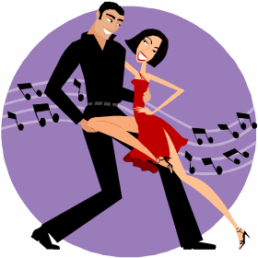
I don’t like it ( not hate )

Slide 26
Je n’aime pas danser.

Slide 27
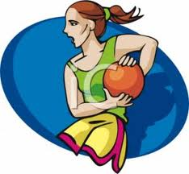
I really like it.

Slide 28
J’aime bien jouer au basket.

Slide 29
I hate it.

Slide 30
Je déteste étudier.

Slide 31
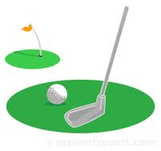
I love it.

Slide 32
J’adore jouer au golfe.

Slide 33
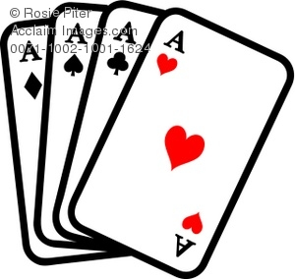
I like it

Slide 34
J’aime jouer aux cartes.

Slide 35
I don’t like it

Slide 36
Je n’aime pas aller au cinéma.

Slide 39
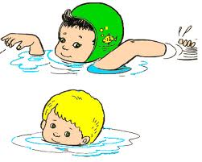
Can you say ?????
they swim

Slide 40
Can you say ?????
ils nagent

Slide 41
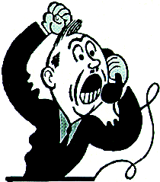
Can you say ?????
he talks on the phone

Slide 42
Can you say ?????
il téléphone

Slide 43
Can you say ?????
Pierre studies

Slide 44
Can you say ?????
Pierre étudie

Slide 45
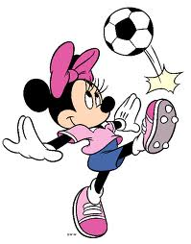
Can you say ?????
They ( all girls )
play soccer.

Slide 46
Can you say ?????
Elles jouent au foot.

Slide 47
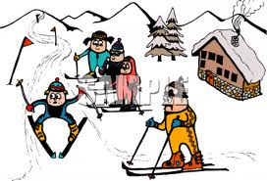
Can you say ?????
You ski
( to Joseph et Yves )

Slide 48
Can you say ?????
Vous skiez.

Slide 49
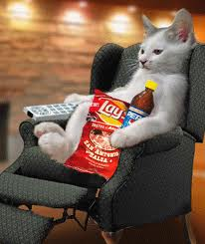
Can you say ?????
You ( your cat Fifi ) watch tv.

Slide 50
Can you say ?????
Tu regardes la télé.

Slide 51
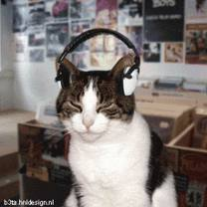
Can you say ?????
I listen to music.

Slide 52
Can you say ?????
J’écoute de la musique.

Slide 53
Can you say ?????
J’écoute de la musique.

Slide 54
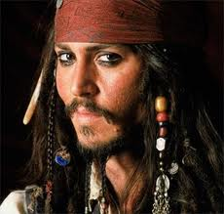
Can you say ?????
We like Johnny Depp.

Slide 55
Can you say ?????
Nous aimons Johnny Depp.

Slide 58
Conversation p. 33

Slide 59
Le temps libre p 34

Slide 60
Write one sentence to say if you like each activity.

